Slide 1
0903 Data collected with Soundcraft mixer and DAQ NI USB-6343

Slide 2
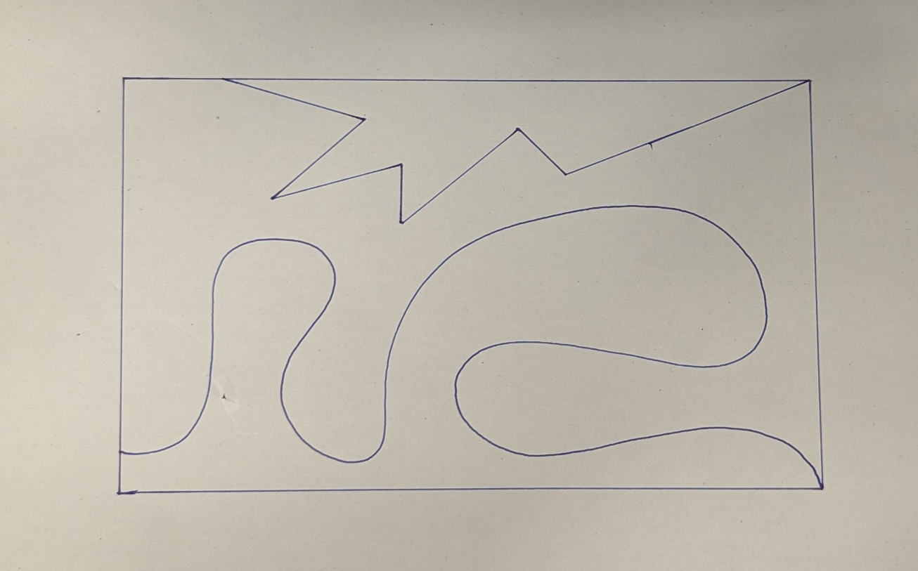
Goals:
Collect data with the accelerometer attached to the upper location of the robot tool and the new connector.
Collection of data in both DAQ and Soundcraft Mixer.
Collect them separately
Actions:
Static: no motion
Motion: Tracing a square
Motion: Tracing a more complicated diagram which includes freehand movements.
Contact: use mini stuff and capture them, have contact made with them.

Slide 3
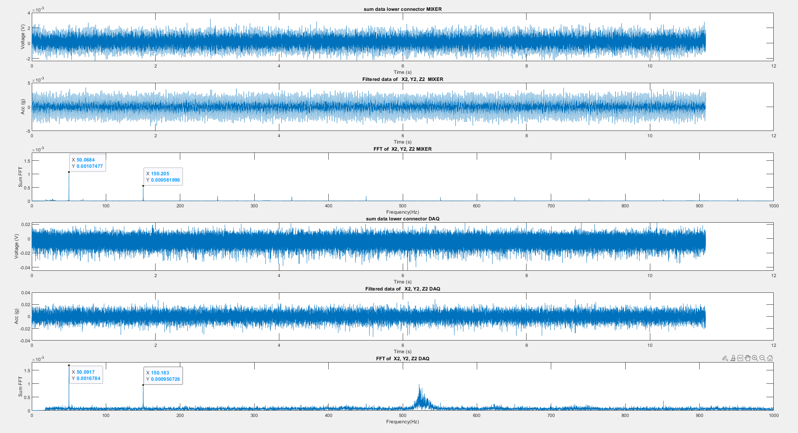
TASK 1: Static

Slide 4
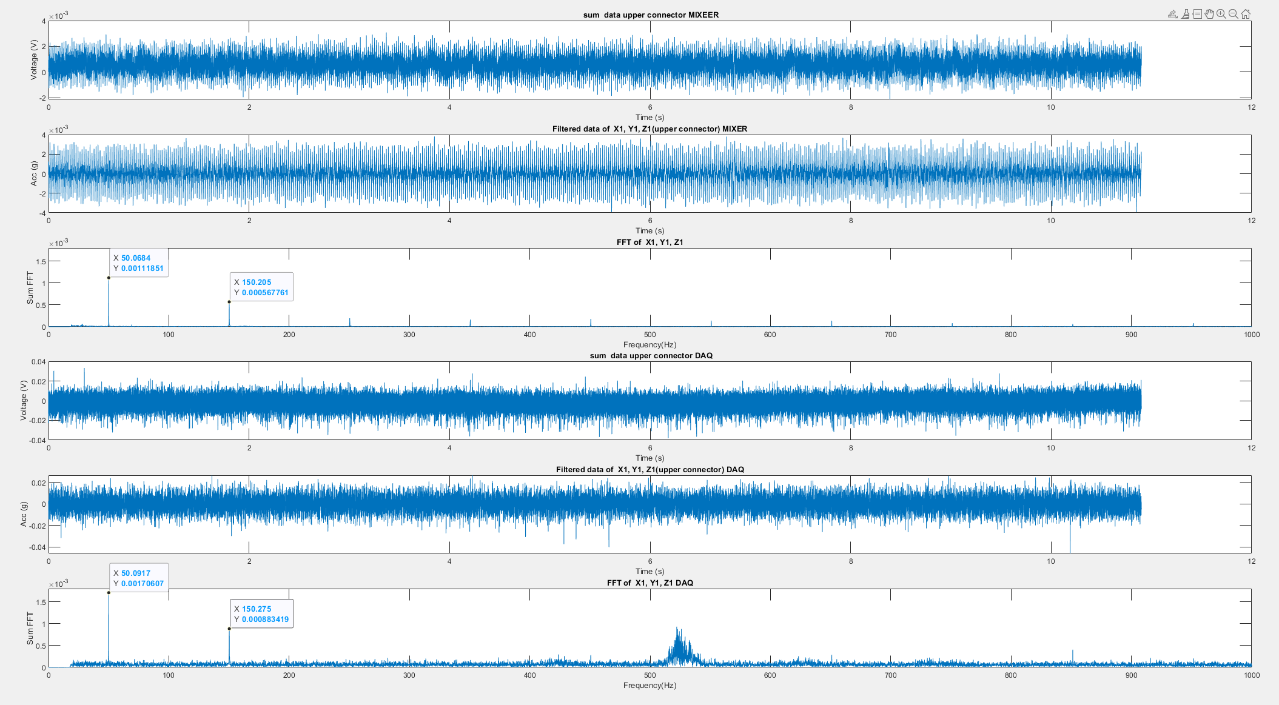

Slide 5
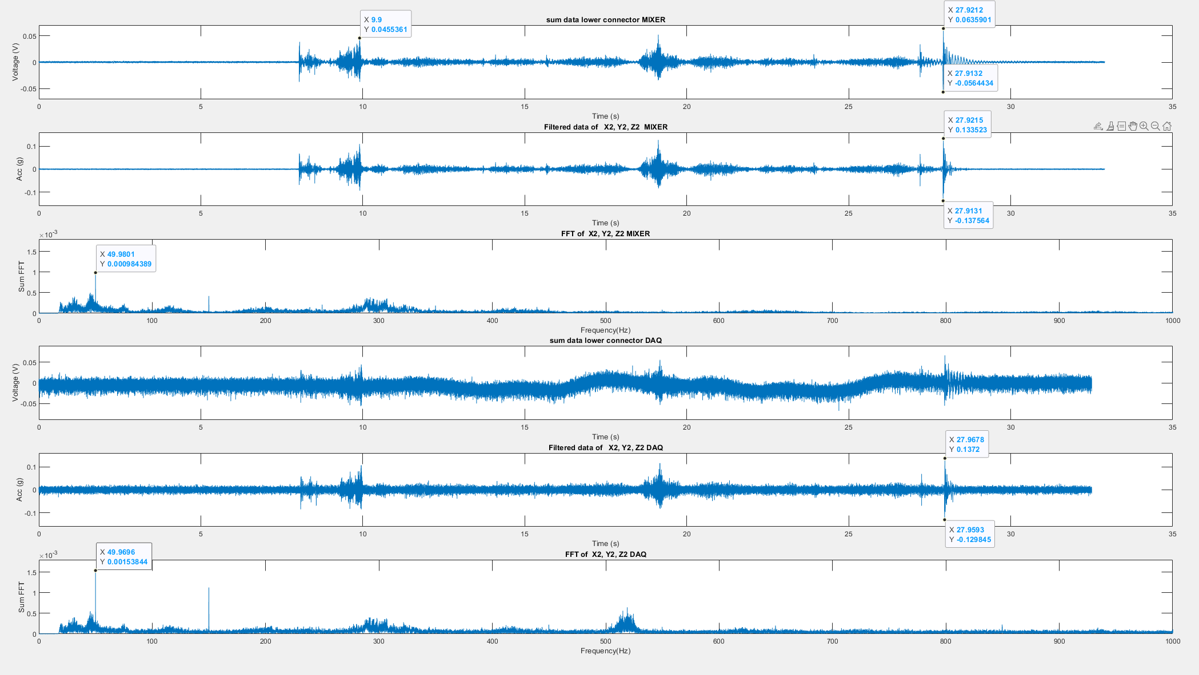
TASK 2: Tracing a Square diagram

Slide 6
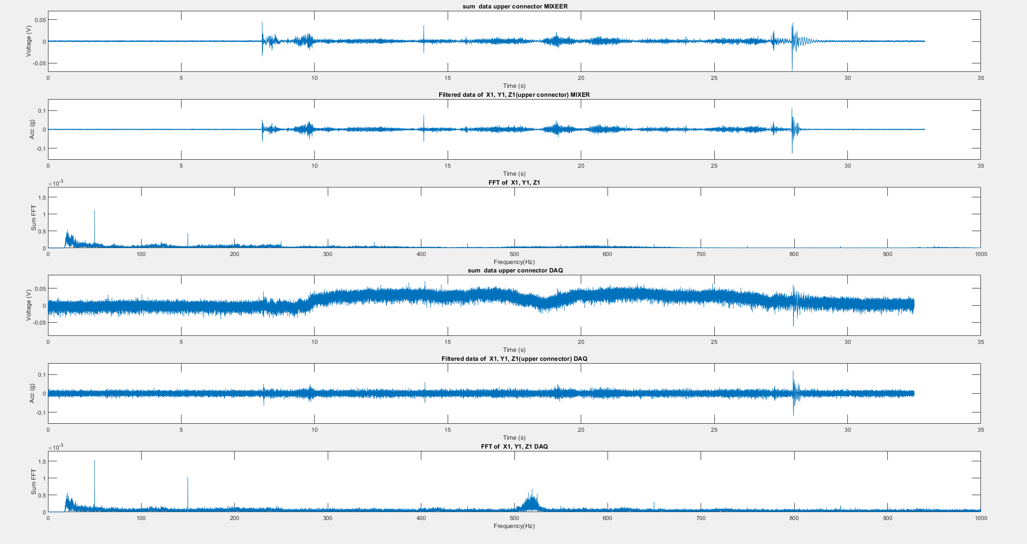

Slide 7
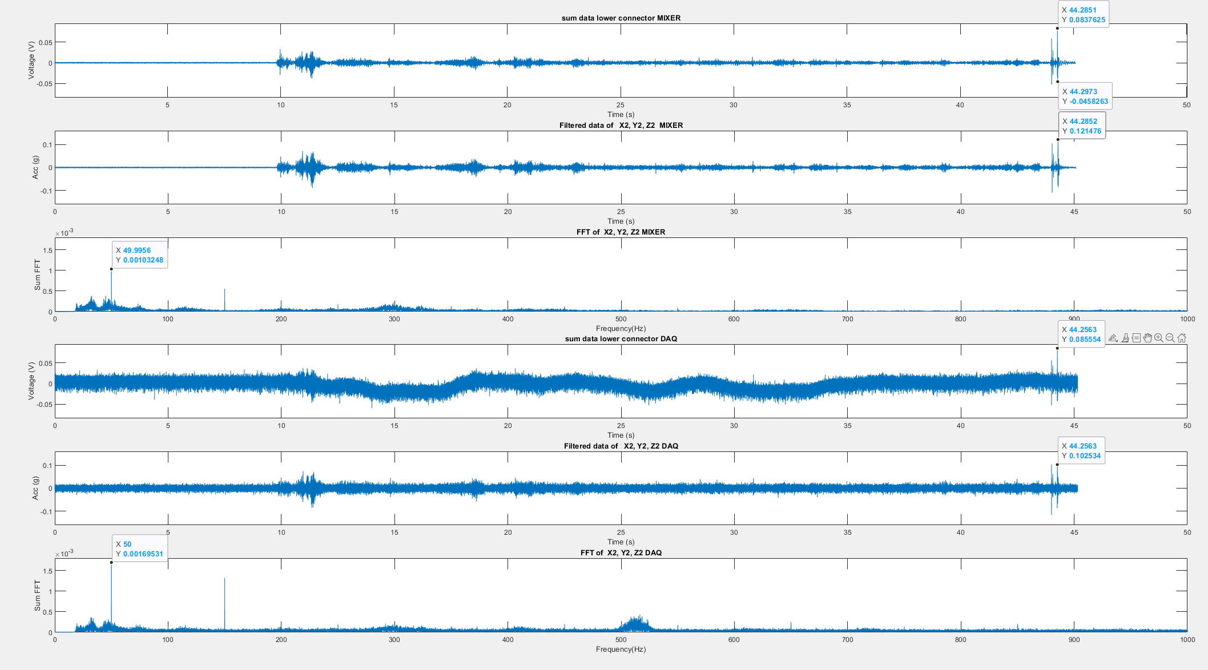
TASK 3:Tracing a square and freehand diagram

Slide 8
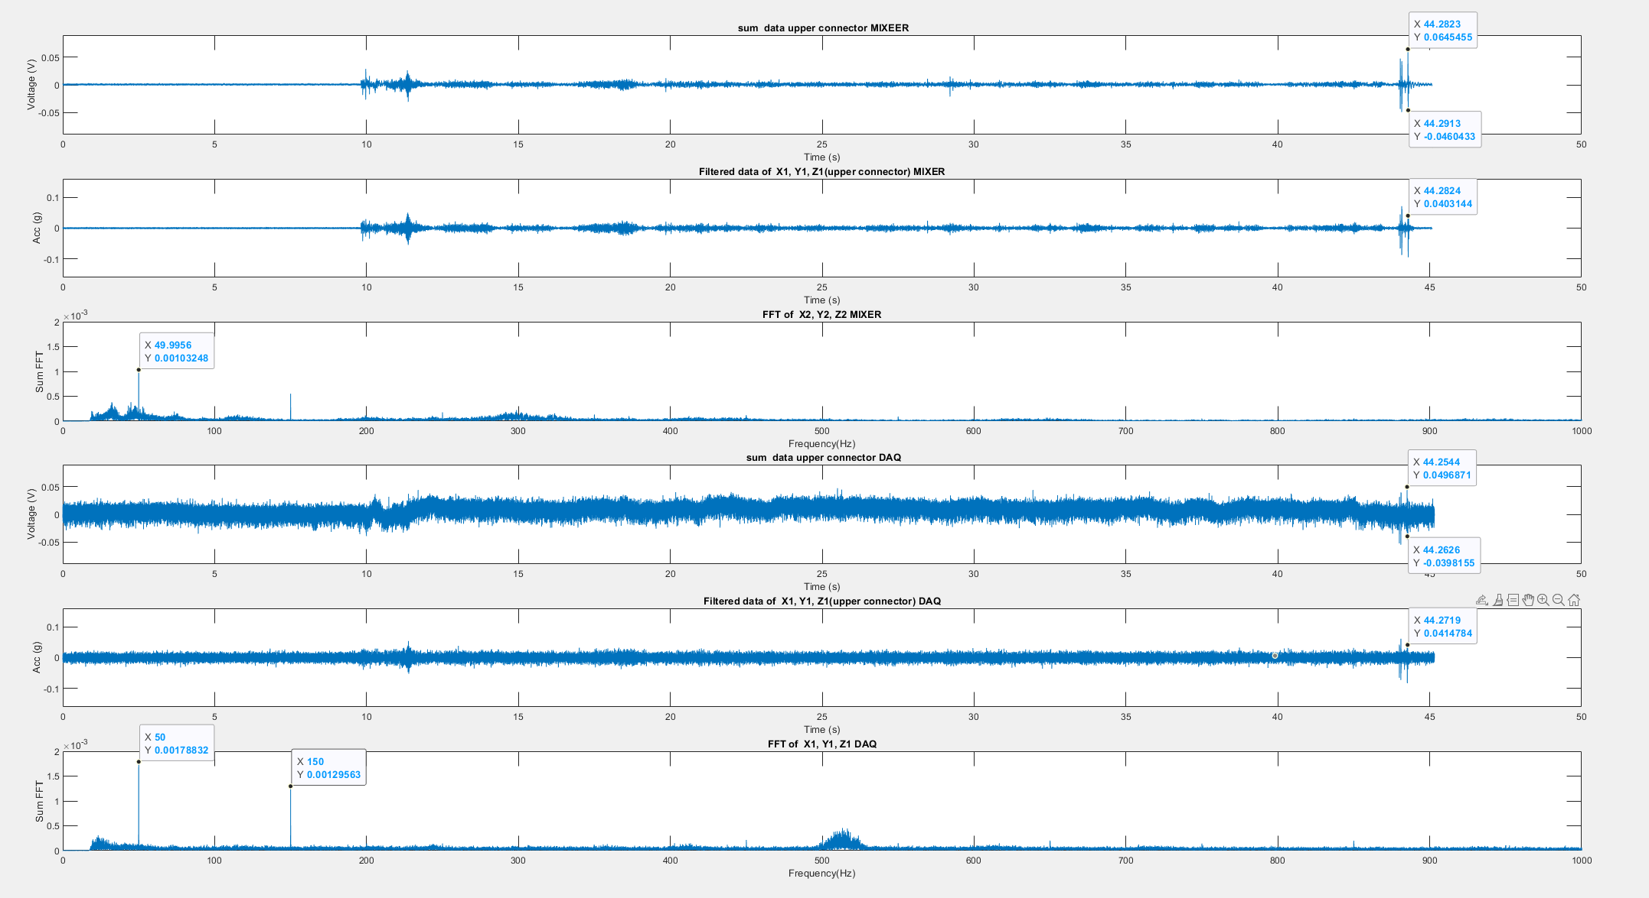

Slide 9
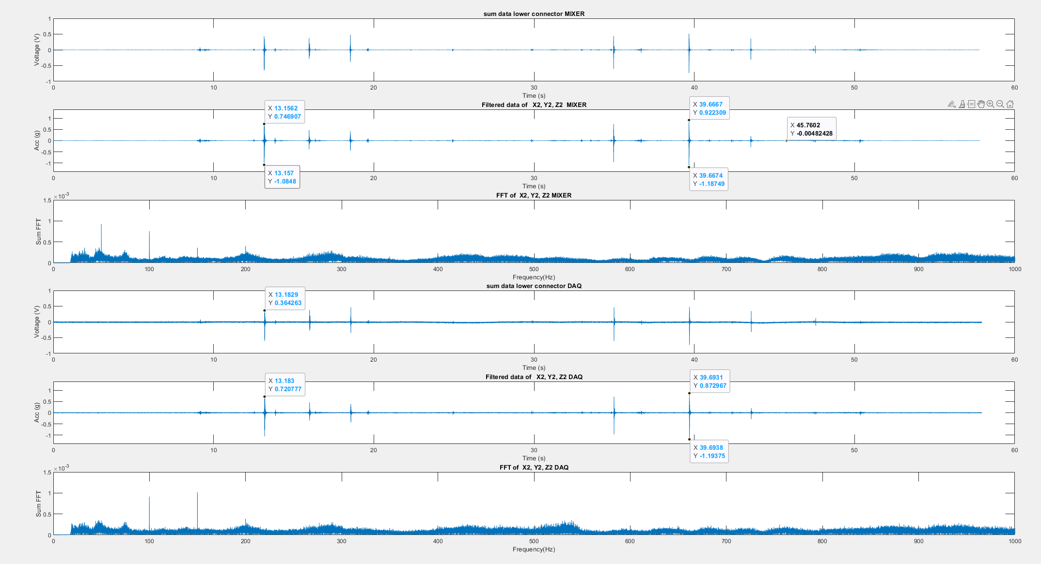
TASK 4: CONTACT WITH SPIKES ON THE BOARD

Slide 10
